Slide 1
Welcome to
5th Grade!
2021-2022 edition

Slide 2
There are many things to look forward to in 5th grade like...

Slide 3
Lockers
Band
Letter Grades
Assignment Board & Assignment Notebooks

Slide 4
Other changes this year:
Lunch & recess with 3rd & 4th grade
Traveling to specialists
Participation at Mass
Extra cleaning
Snack

Slide 5
And now for some curriculum!

Slide 6
Religion
Daily Prayer
Weekly Mass participation
Class mass planning
Textbook, class discussion, worksheets/homework
Saint report, rosary

Slide 7
Language Arts
Houghton Mifflin Journeys textbook and English book to reinforce grammar & writing skills
Weekly story, workbook pages, grammar, vocabulary and spelling test
Writing focuses: informational, persuasive, biography, narrative
Book reports: one each trimester
Reading journals

Slide 8
Math
Math Expressions from Houghton Mifflin
Whole number operations, place value, fractions, decimals, measurement, geometry
There will be practice problems and review problems daily - these will be homework if not completed at school
Assessments for each unit

Slide 9
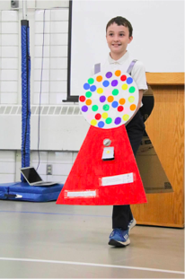
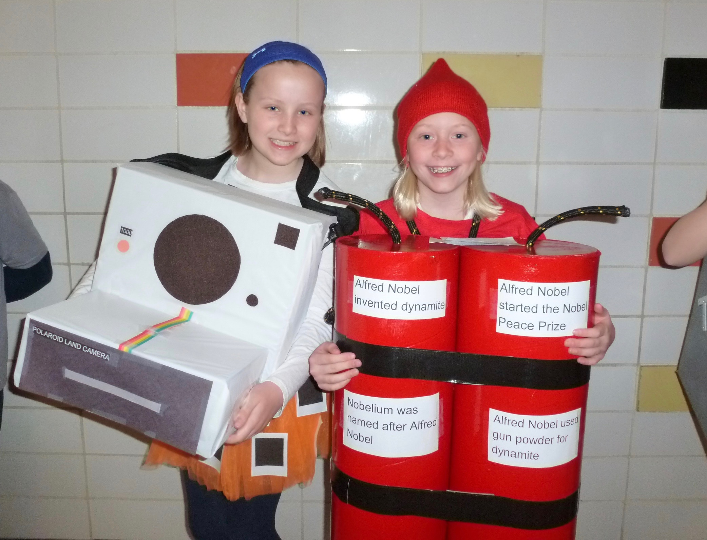
Science
The Nature of Science, Design & Function, Properties of Matter, Forces & Motion, Growth & Survival, Ecosystems, The Water Cycle & Weather, Earth & Space
Textbook, study guides
Tests and Projects, lab activities
Current events - about one per month

Slide 10
Social Studies
American History, Citizenship Skills, Geography, Map Skills, Economics, World Cultures, Social Studies Skills
Learning activities include reading, writing, a variety of projects, research and assessments
Social Studies: Kids Discover the United States textbook
Weekly Geography quizzes
Biweekly current events

Slide 11
Questions?
Please check our class website https://nda-mn-5.weebly.com/ which will have updates on what we’ve been working on, what’s coming up, reminders, photos, and projects.
Feel free to contact me any time if you have questions, comments, or concerns: jdysart@nda-mn.org

